Slide 1
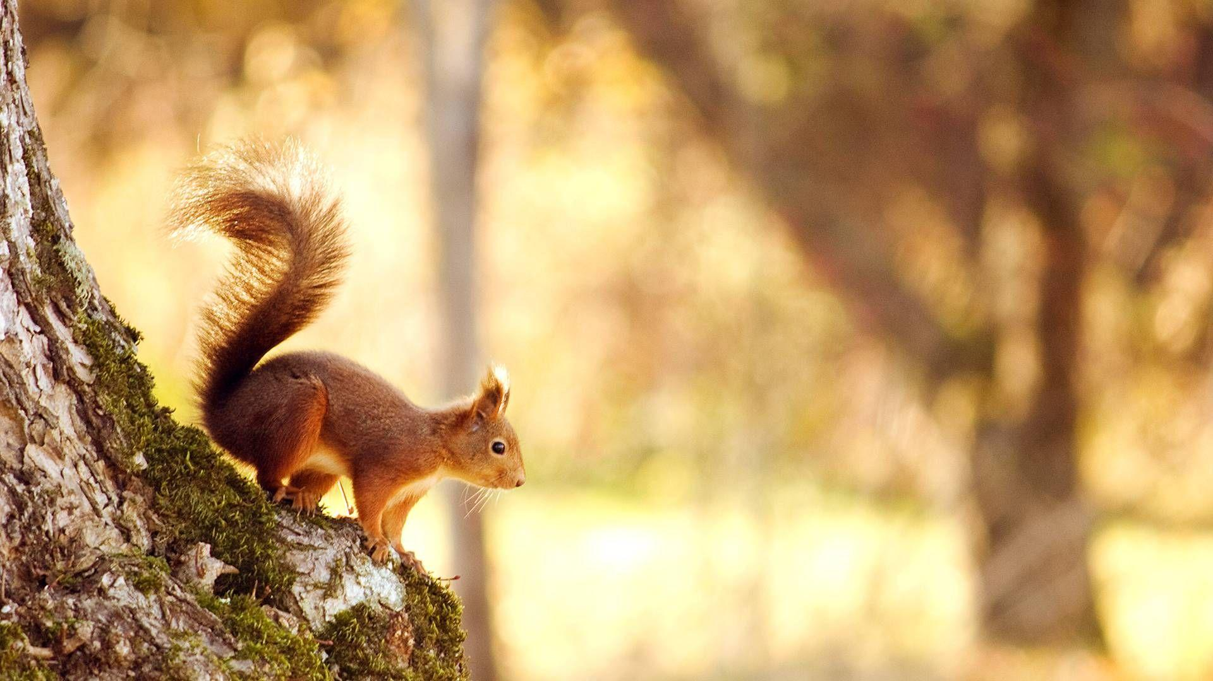
ILLEGAL TRADING OF WILDLIFE ITEMS
ILLEGAL TRADING OF WILDLIFE ITEMS
PRESENTED BY:
MOHAMMED MARZUK T.M,
VIJAYASARATHY.R,
DEENATHAYALAN.P,
PRAHALATHAN.S,
JESTIN VIMALRAJ.A
(Students, B.Sc. Forensic Science, SCAS, Tamil Nadu)
PRESENTED BY:
MOHAMMED MARZUK T.M,
VIJAYASARATHY.R,
DEENATHAYALAN.P,
PRAHALATHAN.S,
JESTIN VIMALRAJ.A
(III year Students, B.Sc. Forensic Science, SCAS, Tamil Nadu)

Slide 2
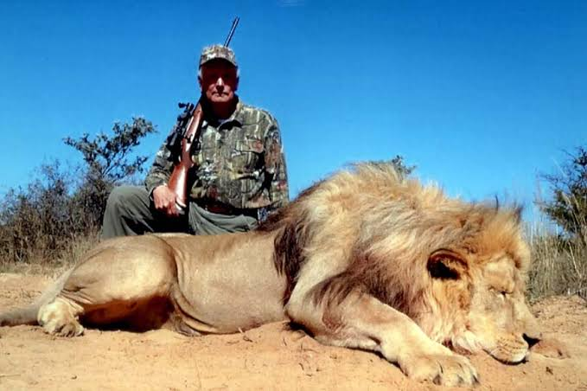
INTRODUCTION
Illegal wildlife trading is selling or exchanging of forest ecosystem related products which includes Animals and Plants or their byproducts.
Some of the wildlife products can be gathered and traded legally with permission from the respected governments so not all wildlife products belong to illegal trading.
Animals at near extinction and rare types of plants are being traded illegally for financial gain.
Specific body parts of several animals are being smuggled for making medicinal products.
Two basic terms that are often used in illegal wildlife trading is POACHING and SMUGGLING.
Poaching is term that refers to illegal hunting of Animals
Figure 1

Slide 3
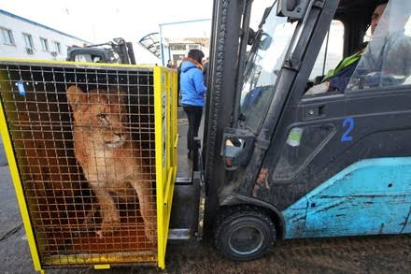
Smuggling is a term that refers to transportation of wildlife products illegally which might be plants and animals [ Dead or Alive ]
Figure 2
Some of the items that are being traded illegally Tiger skin, Elephant ivory, Rhino horn, Sandalwood , Rosewood and etc
Illegal wildlife trade is worth somewhere between$7 billion to $23 billion per year.
Most renowned smuggler in both Tamilnadu and India is veerapan, he was said to be doing illegal wildlife trade for 36 years in his time.
Treaties and Laws were made to prevent this from happening by each countries separately and together as international treaties.

Slide 4
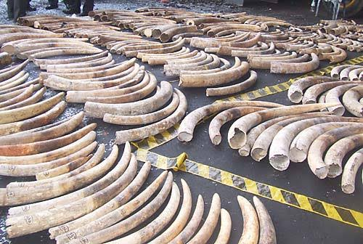
ITEMS BEING TRADED
IVORY
Elephants are being hunted for their ivory ( Tusks ). Ivory is viewed as a material of elegance and bought by people to show their higger status levels.
Ivories are also wanted for making Jewels, Ornaments , Chess pieces and Piano keys.
Traditional Chinese medicine uses both elephant skin and ivory in making medicinal products even though it’s proved to have no medicinal qualities.
In China, Ivory trade has made illegal in 2017 but still about 70% of the ivory products are said to be purchased by Chinese.
1 Gram of ivory is sold between $50 to $100 in blackmarket
Figure 3

Slide 5
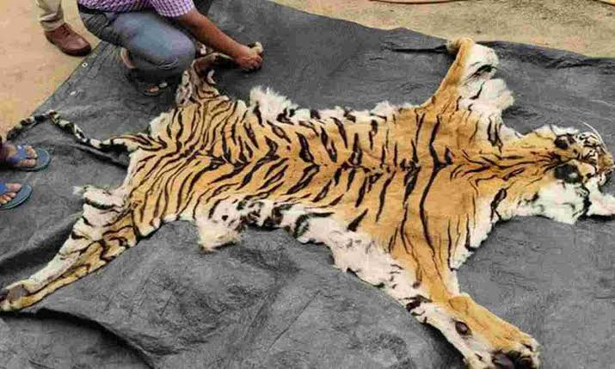
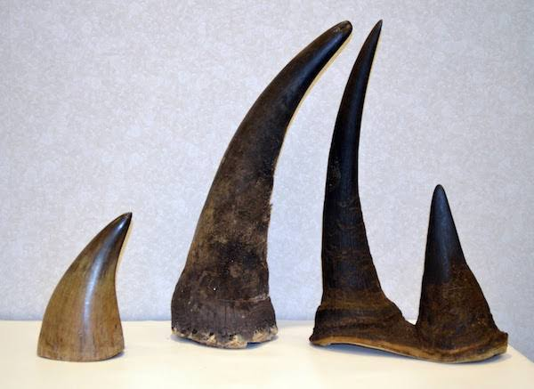
TIGER AND RHINO ( SKIN AND BONE )
Tiger bone and Rhino bone is used in Traditional Chinese medicine and tiger bone is also used to make a beverage called Tiger Bone Wine.
Tiger skins are used as Rugs
Tiger skin and Rhino horn are used as a decorative display product to show wealth.
Population of tigers in India has reduced due to poaching and smuggling of tiger skin.
Price of a tiger skin values upto Rs6 .5 lakhs at minimum and Asian Rhino horn worth $400,000 per kg in blackmarket.
Figure 4
Figure 5

Slide 6
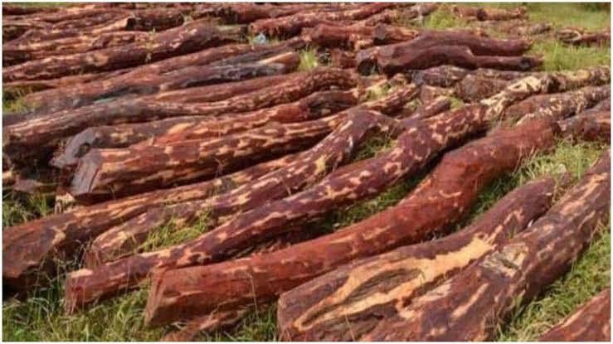
3. SANDALWOOD
Sandalwood is being smuggled to make high end furnitures
They are also useful in making tonics to cure chronic dysentery and diabetes.
Sandalwood smuggling is happening in a large scale at Andhra pradesh and they value upto Rs10 crore for a ton in countries like China, Hong Kong.
OTHER ITEMS
Some of the other wildlife products being smuggled are Pangolin scales, Bear bile juice, Rosewood, Snow Leopard, and Nilgiri Tahr, etc
Figure 6

Slide 7
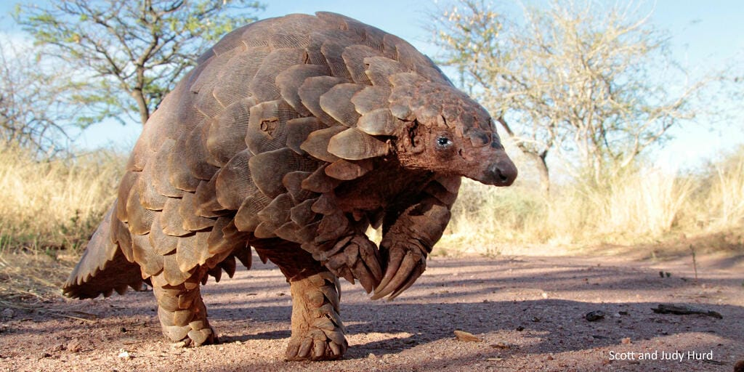
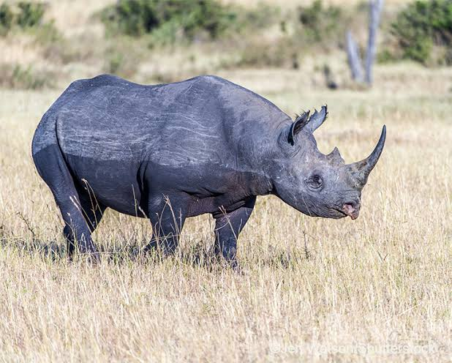
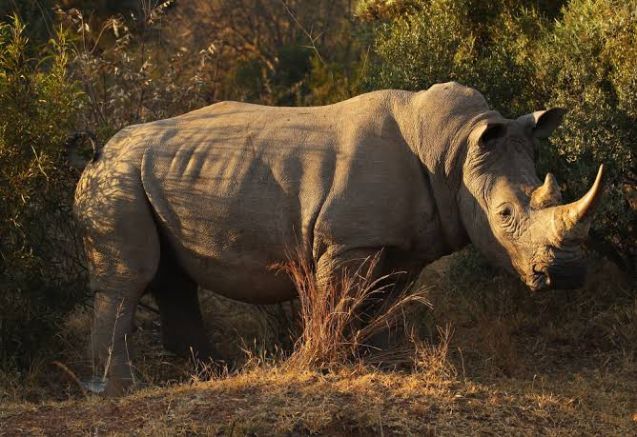
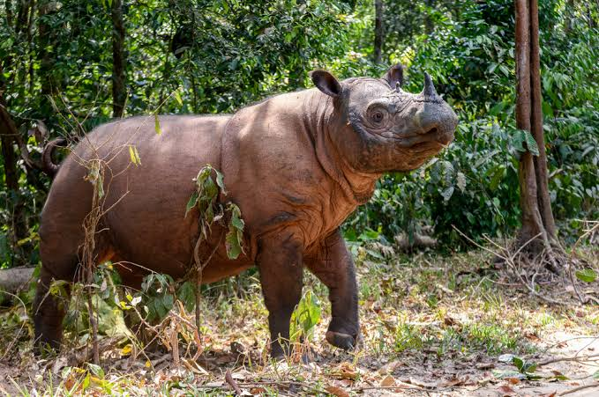
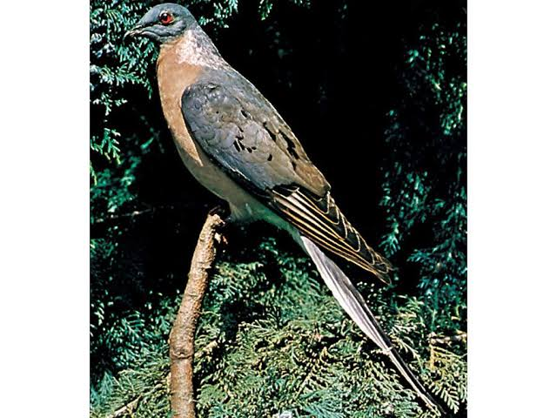
ENDANGERED ANIMALS DUE TO SMUGGLING
Three of the world’s Rhino species are in endangered conditions due to continuous smuggling of them.
Every year, over 100 tigers are smuggled.
Pangolin is the most smuggled mammal.
Some Shark species are in endangered levels and nearly 100 million sharks are killed per year.
Commercial sale of pigeon meat lead to extinction of Passenger Pigeon.
Figure 7
Figure 8
Figure 9
Figure 10
Figure 11

Slide 8
INDIA IN WILDLIFE TRADE
India is a country with vast diversity in plants and animals which results in poaching and smuggling of variety of wildlife items.
Based on a survey by Ministry of environment, forest and climate change in 2017, Animals which are poached between 2015 – 2016 includes Chinkaras, Elephants, Tigers, Peacock, Star Tortoise, Hill Mynah, Deer and many more.
India is trying to prevent Illegal wildlife trade by implementation of Laws
Wildlife Protection Act of 1972 ( WPA ) prevents trade of about 1800 species of wild animals, plants and their derivatives
This act has 60 sections under viii chapters – Section 39 of WPA says any animal hunted, bred, killed, alive or dead is a property to the state government and Section 9 prohibits killing of wild birds.
Indian Penal Code section 428 and 429 says that maiming, killing, poisoning or torturing an animal is an offence . The punishment extends upto 5 years or fine or both.

Slide 9
The Performance Animals Rule of 1973 and Performance Animal ( Registration ) Rule of 2001 states that animals that are trained to perform should be registered to the authority of government and some other rules regarding registration.
India is also a member of a International treaty between countries to regulate trading between nations named CITES [ CONVENTION ON INTERNATIONAL TRADE IN ENDANGERED SPECIES OF WILD FAUNA AND FLORA ]
6610 species of animals and 34,310 species of plants are being protected by this treaty from over exploitation.
India became an CITES member in 1976 and now it has 183 parties.
CITES helps to prevent illegal trading of wildlife items and provides regulations for legal trading.

Slide 10
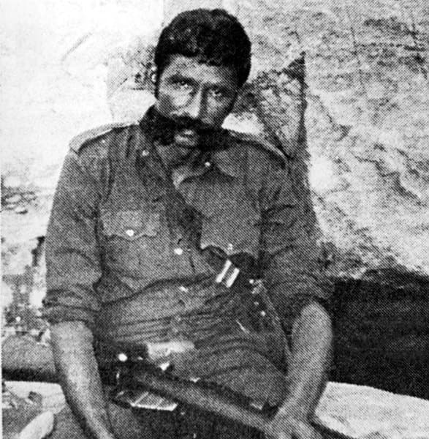
Case study
Name: Koose Munisamy Veerappan Gounder
Born: 18 January 1952, Gopinatham
Death: 18 October 2004, Papparapatti
Span of Crimes: 1962 to 2004
Figure 12
Veerappan started his criminal career by assisting his uncle Saalvai Gounder who was a known Poacher and Sandlewood smuggler.
He started with ivory smuggling killing elephants and sandlewood smuggling which he later became well known for.
He was first arrested for murder in the age of 17 and began killing the persons resisting his illegal activities, mostly police officers, forest officers, informants.
He drew the attention of police and forest department after kidnapping and killing the Taluk forest officer of Sathyamangalam in 1987.
In 1990 Karnataka forest officers in collaboration with Tamil Nadu and Karnataka police seized 65 metric tons of Sandlewood on the day of Veerappan’s marriage which remains biggest seize of sandlewood in the world till today.
This raid shattered Veerappan’s growing smuggling business for which the brigand answered by killing 4 police officers.
After this incident Karnataka government formed a Special Task Force to begin a manhunt for Veerappan.

Slide 11
He brutally killed IFS officer Pandillapalli Srinivas in November 1991 taking his head after killing as a revenge for his sister’s suicide.
After the death of his subordinate Gurunath who was killed by Shakeel Ahamed a Karnataka police officer, Veerappan raided Ramapura police station killing 7 policemen brutally.
Joint special task force was created by Tamil Nadu and Karnataka governments with Sanjay Arora and Shankar Bidari in respective states in 1992.
Then in August 1992 Veerappan ambushed the car of IPS Harikrishna and Sub inspector Shakeel Ahamed and killed them brutally on open fire
On April 9 1993, Veerappan killed 22 Police officers in a bomb blast in Palar which was targeted for Gopalakrishnan a Tamil Nadu police officer who created Jungle Patrol and known for his harsh methods of investigating public.
After this incident Veerappan called on a Photo journalist Subramanian and for the first time since his criminal career Police got to see the photo of mighty Veerappan.
This turned out to be the brigand biggest mistake as Sanjay Bidari came into scene cutting of the food supply to Veerappan and catching the members of him with the help of the photos released.
Later STF found the hiding place of Veerappan’s crew members in Minchuguli and over 157 members of Veerappan were either arrested or shot to death including women, children. Veerappan’s wife was arrested.
After this incident gang members of Veerappan reduced to just 5 to 6.

Slide 12
Upon this immense blow, Veerappan managed to elude police for next 7 years and on July 30 2000 Veerappan kidnapped Kannada superstar Rajkumar along with 3 others and held them for 108 days. He later released them for 20 crore.
On 25th August 2002 Veerappan kidnapped H.Nagappa a former minister of Karnataka but police failed to retrieve him as he was found dead later.
Finally after eluding the 2 state’s police for over 2 decades under the Operation named “Operation Cocoon” carried out by Tamil Nadu STF under the leadership of IPS Vijaykumar, Veerappan was shot to dead in an ambulance drove by an undercover police officer in Papparapatti, Dharmapuri on 18 October 2004, along with his 2 subordinates.
This manhunt for Veerappan totally costed nearly a billion for Indian Government which is till date the costliest manhunt ever happened in India.

Slide 13
Conclusion
Illegal wildlife trading involves killing and smuggling of either Animals or Plants without permission for financial gain.
It increases the possibility of endangering and extinction of Animals.
Even though, laws are available in every countries. It is still being an tough task to stop illegal trading.
Wildlife items like Ivory and Tiger skin are being bought by people to show their wealth and prosperity.
People in china buy about nearly 70% of many wildlife items due to superstition like believing some of them can be used as medicinal products.

Slide 14
REFERENCE
Wikipedia contributors. (2023b). Veerappan. Wikipedia. https://en.m.wikipedia.org
Illegal trafficking and poaching laws in India. (n.d.). https://www.legalserviceindia.com
What is Poaching? The Illegal Wildlife Trade Explained. (n.d.-b). World Wildlife Fund. https://www.worldwildlife.org
Rosen, T. (n.d.). The evolving war on illegal wildlife trade. International Institute for Sustainable Development. https://www.iisd.org
Illegal wildlife trade in India. (n.d.). WWF India. https://www.wwfindia.org
Rhino | Species | WWF. (n.d.). World Wildlife Fund. https://www.worldwildlife.org
Figure 1 : The Humane Society of the United States. (2016). Ending the madness of international trophy hunting of rare animals. A Humane World. https://blog.humanesociety.org
Figure 2 : Publishing, F. (n.d.). BORYSPIL, DECEMBER 9 - Lion in a transport cage is driven by a. . . Getty Images. https://www.gettyimages
Figure 3 : Ndlovu, R. (2019, June 10). Zimbabwe wants to sell Ivory stockpile, may withdraw from CITES. Bloomberg.com. https://www.bloomberg.com/news/articles/2019-06-10/zimbabwe-may-consider-cites-withdrawal-to-sell-ivory-stockpile

Slide 15
Figure 4 : Trends, N. (2023, June 22). Two individuals were Arrested for poaching, and a tiger skin has been seized as evidence. Nagpur Trends. https://www.nagpurtrends.com
Figure 5 : Muñoz-Alonso, L. (2014, November 27). Canadian dealer pleads guilty to rhino horns smuggling attempt. Artnet News. https://news.artnet.com
Figure 6 : Why you shouldn’t use red sandalwood. An endangered species of Santalum. (2019, July 10). SS Champion. https://www.sschampion.com
Figure 7 : Kelly, B. G. (2016, March 15). Pangolins: 13 facts about the world's most hunted animal. The Telegraph. https://www.telegraph.co.uk
Figure 8 : Guiver, S. (2022). Eastern Black Rhino. World Land Trust. https://www.worldlandtrust.org
Figure 9 : Romo, V. (2023, April 27). 2,000 “near threatened” white rhinos are up for auction. Northern Public Radio: WNIJ and WNIU. https://www.northernpublicradio.org
Figure 10 : Whitlatch, C. (2021). The community saving the Sumatran rhino. Save the Rhino. https://www.savetherhino.org
Figure 11 : The Editors of Encyclopaedia Britannica. (2023, July 27). Passenger pigeon | Description, History, Extinction, & Facts. Encyclopedia Britannica. https://www.britannica.com
Figure 12 : John, E. (2021). The Legend of Veerappan – The Story You Need To Hear. PinkLungi. https://pinklungi.com

Slide 16
THANKYOU

